Slide 1
Internet Protocol
INTERNET PROTOCOL

Slide 2
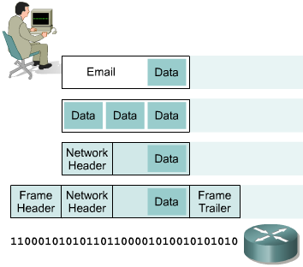
IP as a Routed Protocol
Internet Protocol
IP is a connectionless, unreliable, best-effort delivery protocol.
IP accepts whatever data is passed down to it from the upper layers and forwards the data in the form of IP Packets.
All the nodes are identified using an IP address.
Packets are delivered from the source to the destination using IP address

Slide 3
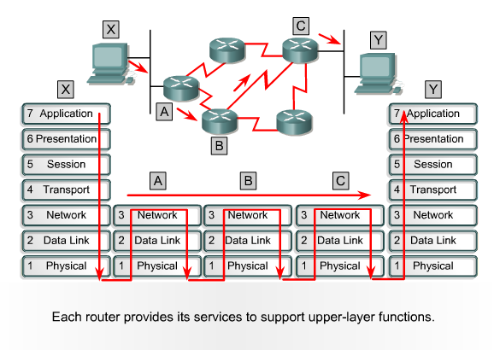
Packet Propagation
Internet Protocol

Slide 4
IP Address
Internet Protocol
IP address is for the INTERFACE of a host. Multiple interfaces mean multiple IP addresses, i.e., routers.
32 bit IP address in dotted-decimal notation for ease of reading, i.e., 193.140.195.66
Address 0.0.0.0, 127.0.0.1 and 255.255.255.255 carries special meaning.
IP address is divided into a network number and a host number.
Also bits in Network or Host Address cannot be all 0 or 1.

Slide 5
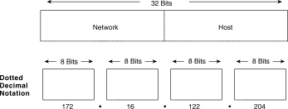
IP Address
Internet Protocol

Slide 6
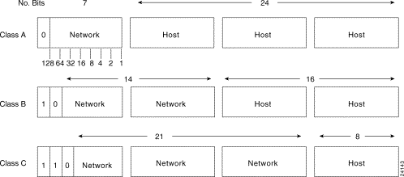
IP Address
Internet Protocol

Slide 7
IP Address
Internet Protocol
Class A : Address begins with bit 0. It has 8 bit network number (range 0.0.0.0-to-127.255.255.255), 24 bit host number.
Class B : Address begins with bits 10. It has 16 bit network number (range 128.0.0.0-to-191.255.255.255), 16 bit host number.
Class C : Address begins with bits 110. It has 24 bit network number (range 192.0.0.0-to-223.255.255.255), 8 bit host number.
Class D : Begins with 1110, multicast addresses (224.0.0.0-to-239.255.255.255)
Class E : Begins with 11110, unused

Slide 8
Subnet Mask
Internet Protocol
Consider IP address = 192.168.2.25
  First few bits (left to right) identify network/subnet
  Remaining bits identify host/interface
Number of subnet bits is called subnet mask, e.g.
  Subnet IP Address range is 192.168.2.0 – 192.168.2.255 or Mask = 255.255.255.0
  Subnet IP Address range is 192.168.2.0 – 192.168.2.15 or Mask = 255.255.255.240

Slide 9
IP Address, Subnet Mask and Gateway
Internet Protocol
IP Address and Subnet Mask define the Subnet
For Example IP address 172.31.1.0 and Subnet Mask of 255.255.240.0 means that the subnet address ranges from 172.31.0.0 to 172.31.15.255
Another notation is 172.31.1.0/28
The first Address is the Network Address and the last Address is the Broadcast Address. They are reserved and cannot be assigned to any node.
The Gateway Address is the Address of the router where the packet should be sent in case the destination host does not belong to the same subnet

Slide 10
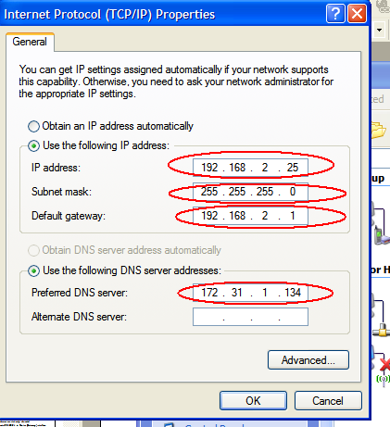
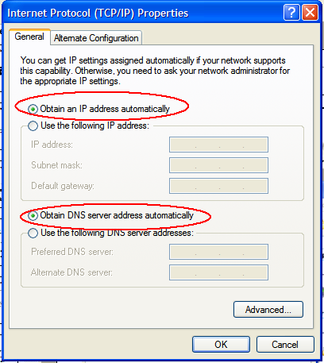
IP Configuration of an Interface
Internet Protocol
Static
DHCP

Slide 11
ARP
Internet Protocol
ARP (Address Resolution Protocol) is used in Ethernet Networks to find the MAC address of a node given its IP address.
Source node (say 192.168.2.32) sends broadcast message (ARP Request) on its subnet asking ``Who is 192.168.2.33’’.
All computers on subnet receive this request
Destination responds (ARP Reply) since it has 192.168.2.33
  Provides its MAC address in response

Slide 12
IPv6
Internet Protocol
Internet Protocol Version 4 is the most popular protocol in use today, although there are some questions about its capability to serve the Internet community much longer.
IPv4 was finished in the 1970s and has started to show its age.
The main issue surrounding IPv4 is addressing—or, the lack of addressing—because many experts believe that we are nearly out of the four billion addresses available in IPv4.
Although this seems like a very large number of addresses, multiple large blocks are given to government agencies and large organizations.
IPv6 could be the solution to many problems posed by IPv4

Slide 13
IPv6
Internet Protocol
IPv6 uses 128 bit address instead of 32 bit address.
The IPv6 addresses are being distributed and are supposed to be used based on geographical location.

Slide 14
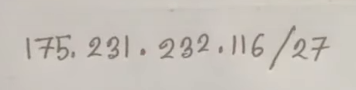
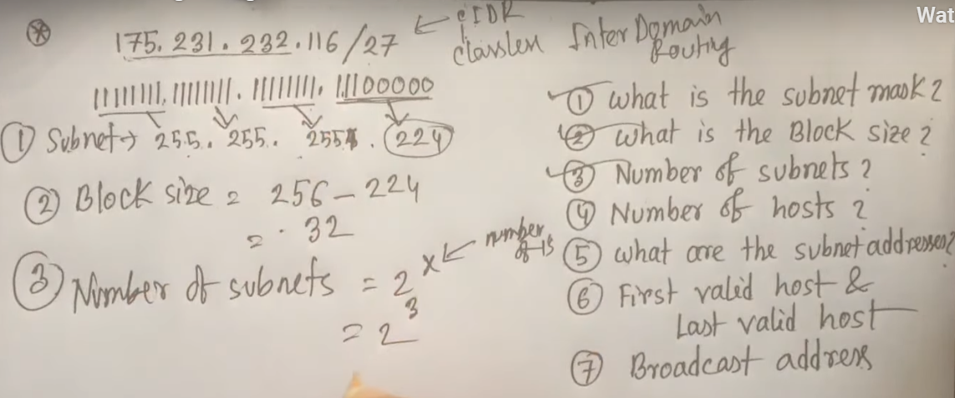
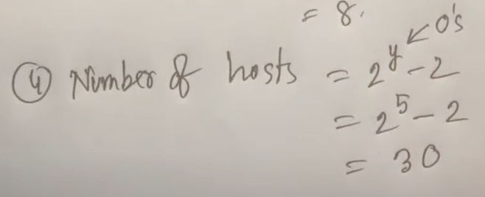

Slide 15
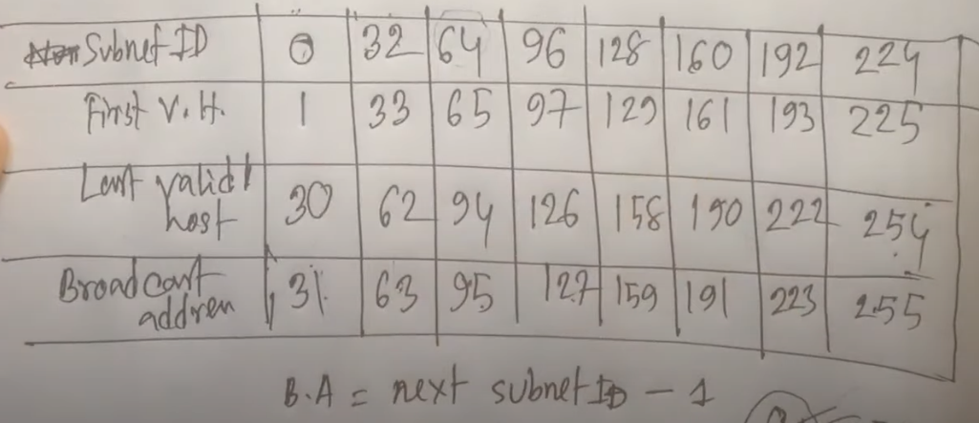

Slide 16
